Slide 1
A Reinforcement Learning Agent to Play Risk
Alex Goodall and Jon Barnes-Nunn

Slide 2
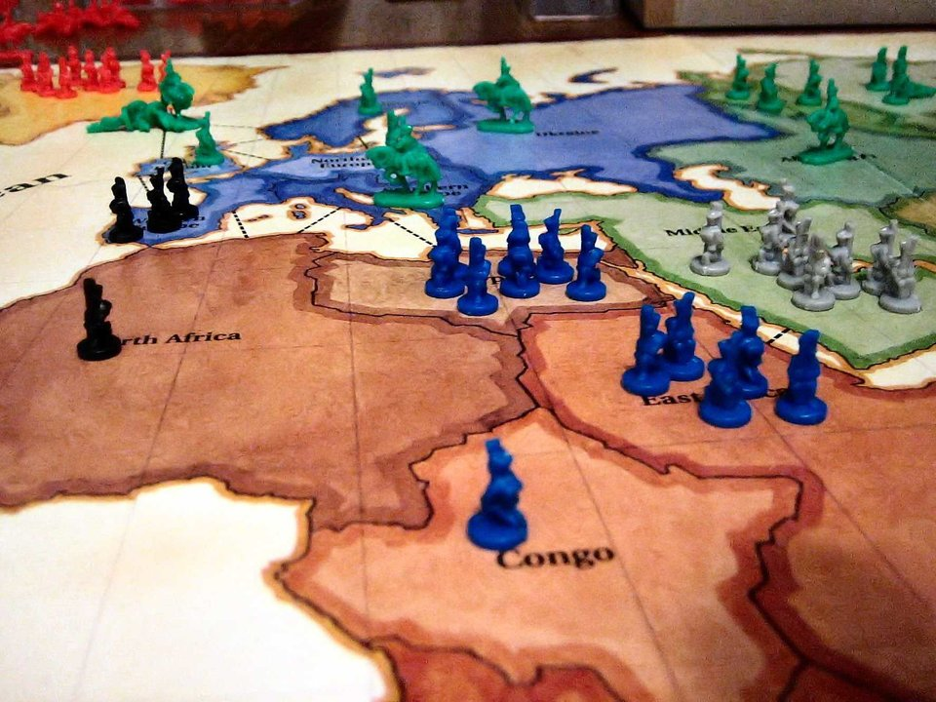
What is Risk?
Aim: Capture all Territories
Three phase turns:
Reinforce
New units based on current territories
Attack
Can battle other players for their territory
Fortify
Move troops to different owned territories

Slide 3
Simplification
Only use half of the board – reduce initial troops accordingly
Remove fortification phase
No retreat after attacking, attack with max units
Exactly 3 players
No attack cards or objectives
No max number of units

Slide 4
Random Agent
Reinforcement
Each unit is added to a random owned territory
Attack
List all potential attacks
Randomly pick one if random number below aggressiveness threshold
Repeat until random number falls below aggressiveness threshold

Slide 5
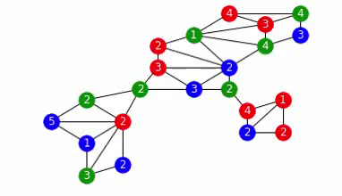
Random Agent Game Example

Slide 6
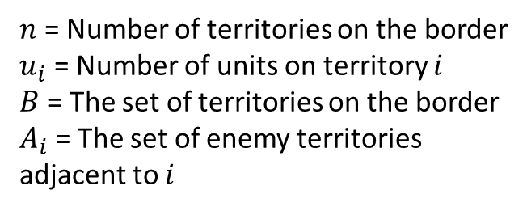
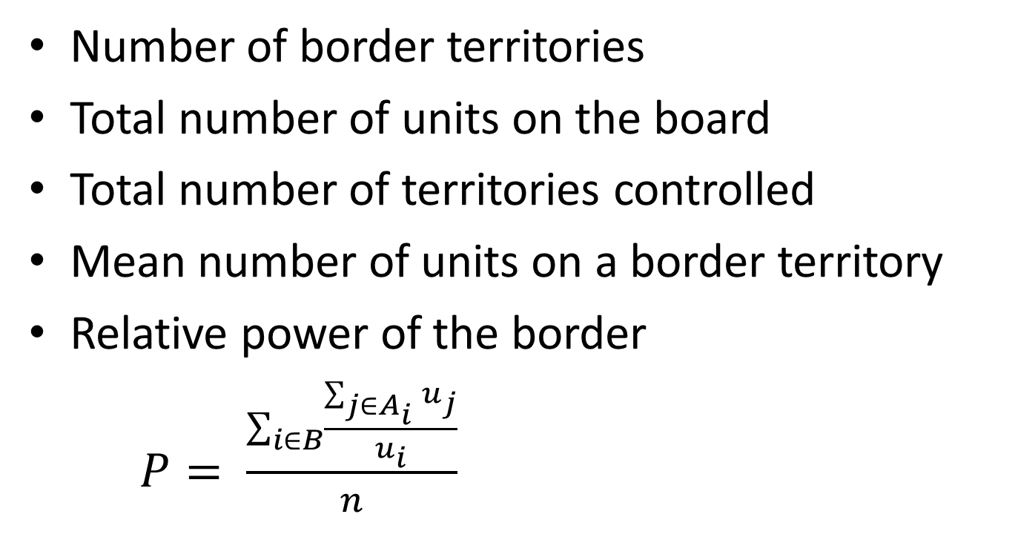
Features used
Number of border territories
Total number of units on the board
Total number of territories controlled
Mean number of units on a border territory
Relative power of the border
$P= \frac{\sum_{i∈B}{\frac{\sum_{j∈A_{i}}{u_{j}}}{u_{i}}}}{n}$
$n$ = Number of territories on the border
$u_{i}$ = Number of units on territory $i$
$B$ = The set of territories on the border
$A_{i}$ = The set of enemy territories adjacent to $i$

Slide 7
Memory issues

